Slide 1

Deeper Insights
Developing a Deep Learning Algorithm for Climate Change Prediction

Slide 2

The Problem
According to the Department of Civil Engineering and Environmental Sciences at LMU, climate change projections continue to be dominated by large uncertainties.
Complex dynamic models
Outdated statistical models
Computationally inefficient “ensemble methods”

Slide 3
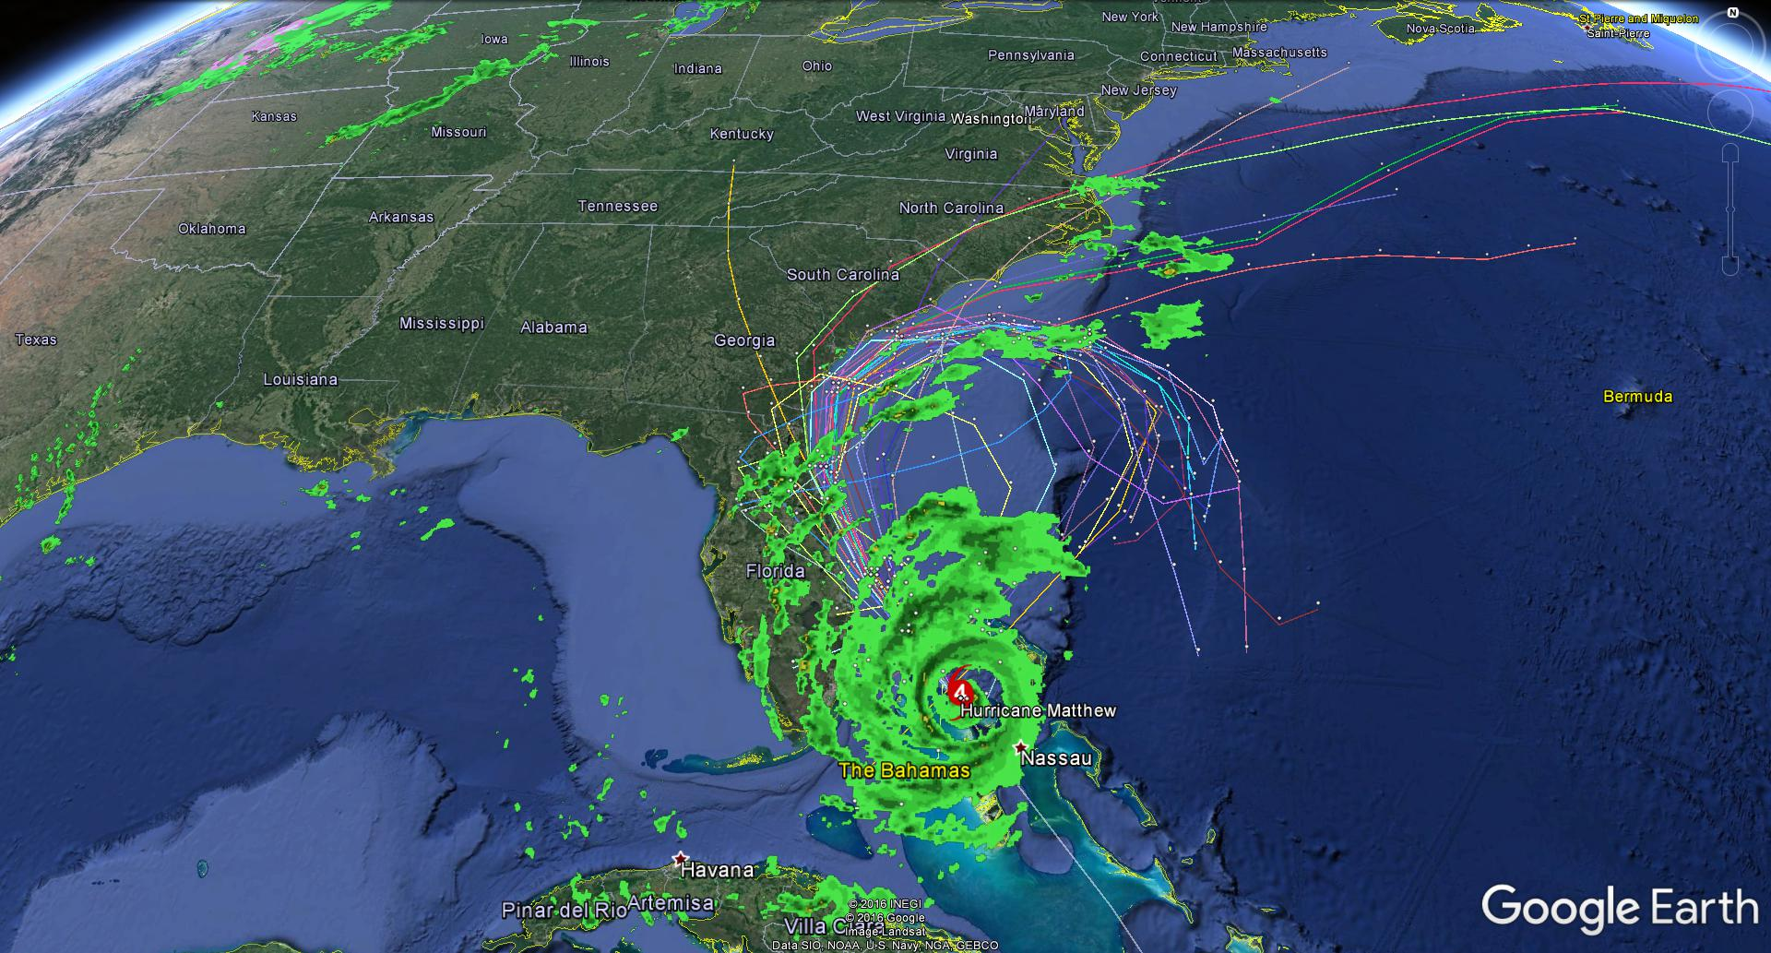
Hurricane Trajectory Prediction

Slide 4
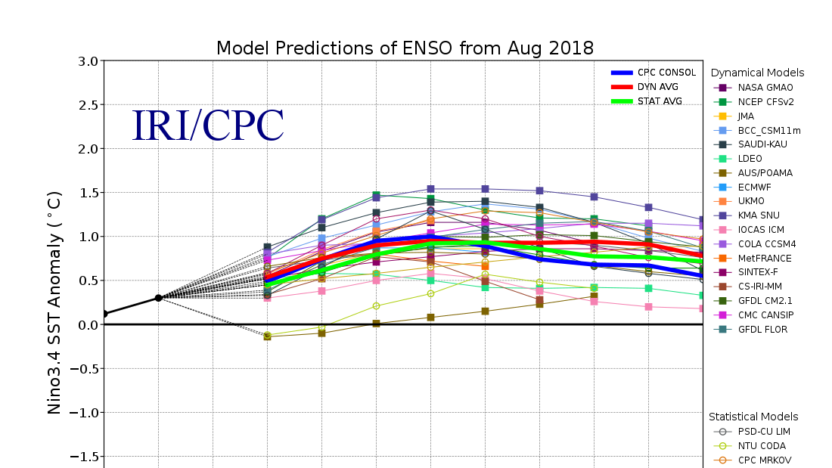
Predicting El Niño

Slide 5

The Solution
Thanks to recent research in the field of Artificial Intelligence, in particular the success of Deep Learning algorithms to take advantage of big data, combined with the availability of Earth observations from space and from the ground, breakthroughs appear to be within reach.
Deep Learning Algorithms
High availability of data
Cheap accessibility to cloud computing

Slide 6

Goals
Harness the power of big data
Defeat the accuracy of currently used statistical and dynamical models
Produce an algorithm that is fast and simple

Slide 7
Justification
We are interested in this project because:
Passion for data science
Climate change social justice (raise awareness)
We are able to perform this project because:
Math interests and abilities
Previous experience with Big Data and Machine Learning

Slide 8
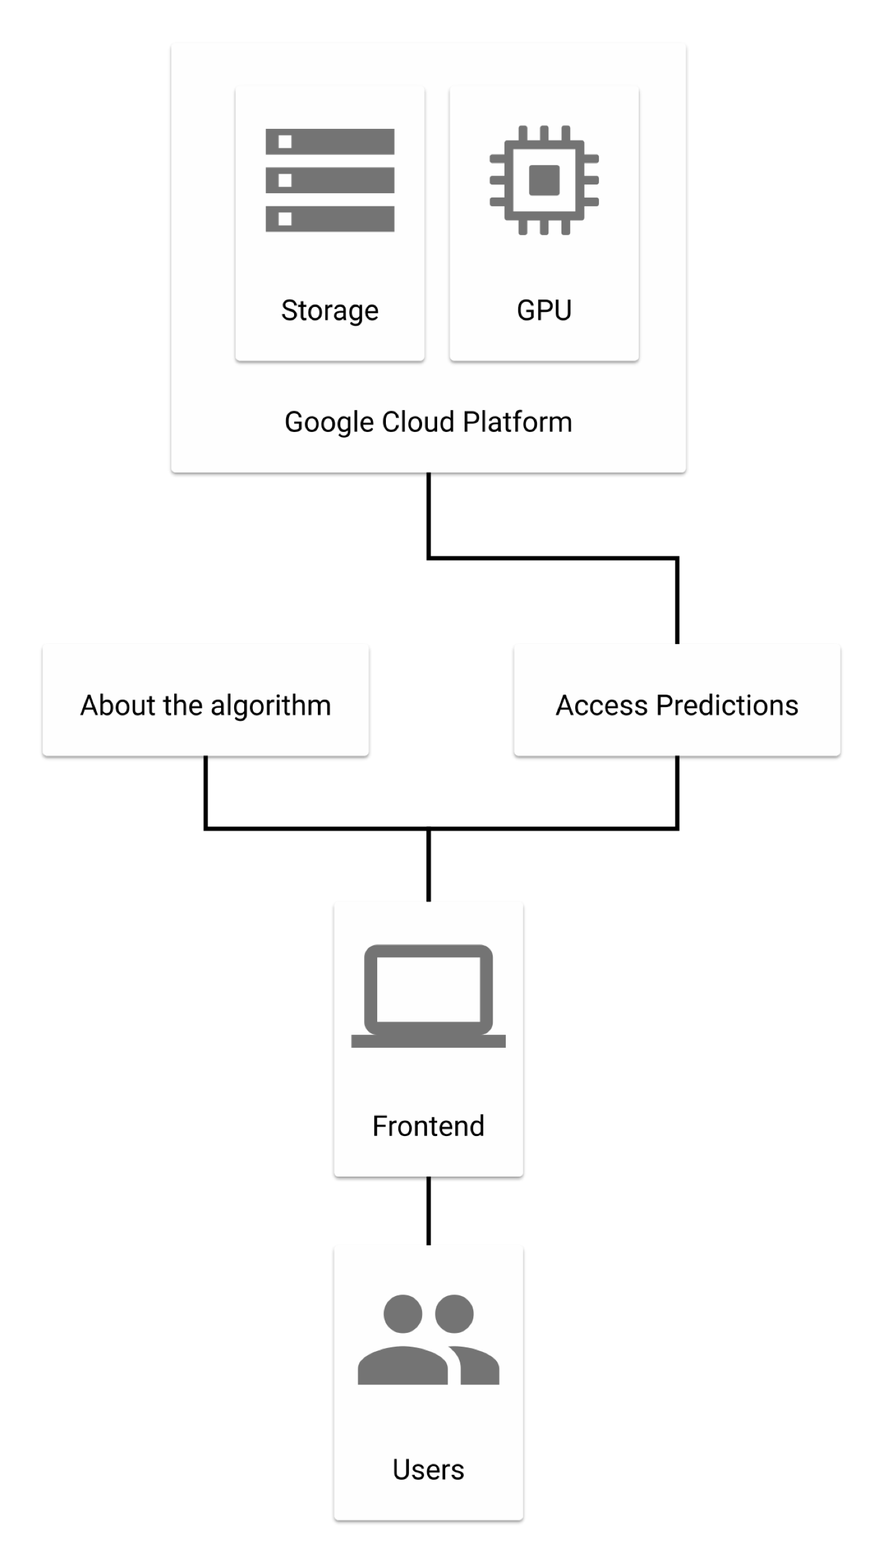
Use Case diagram

Slide 9
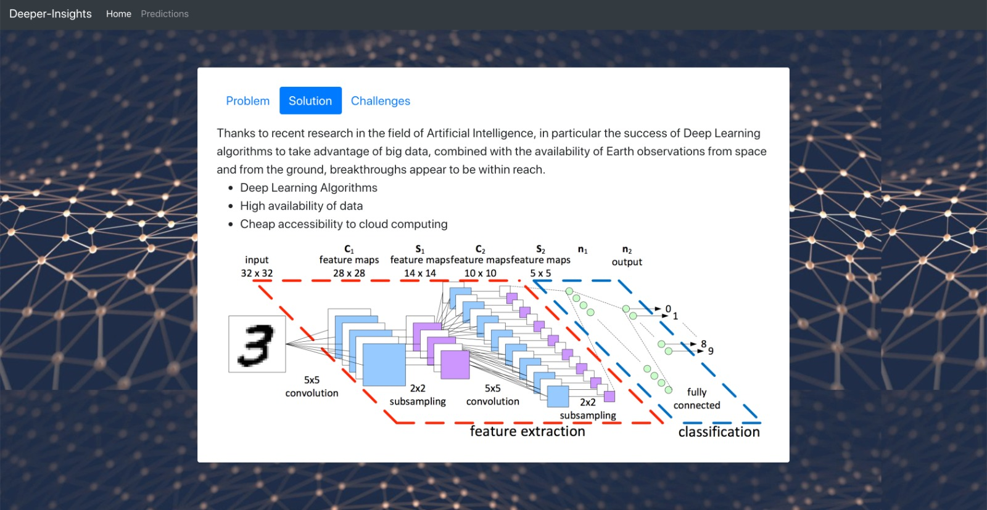
UI

Slide 10
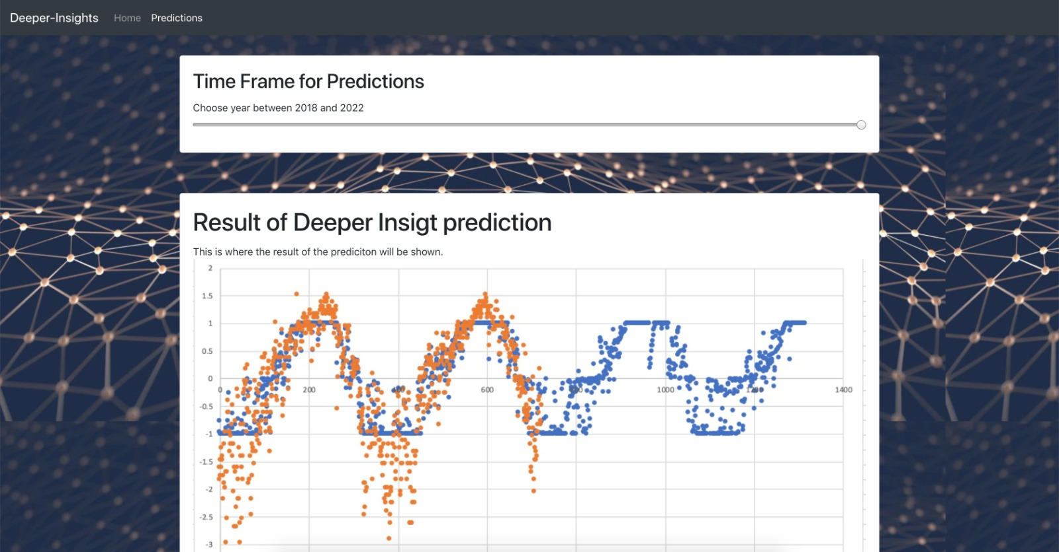
UI

Slide 11
Features (inputs):
Latitude
Longitude
Zonal Winds
Meridional Winds
Humidity Air Temperature
Labels (outputs):
Sea Surface Temperature
Data range of time: 1980-1990
Missing values: yes
The Training Data

Slide 13
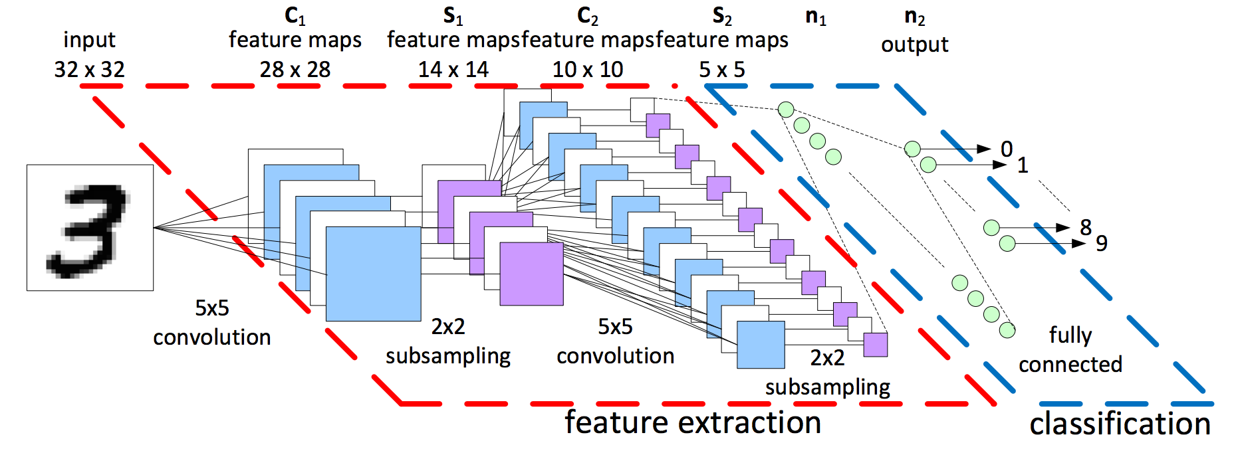
Convolutional Neural Netwroks

Slide 14
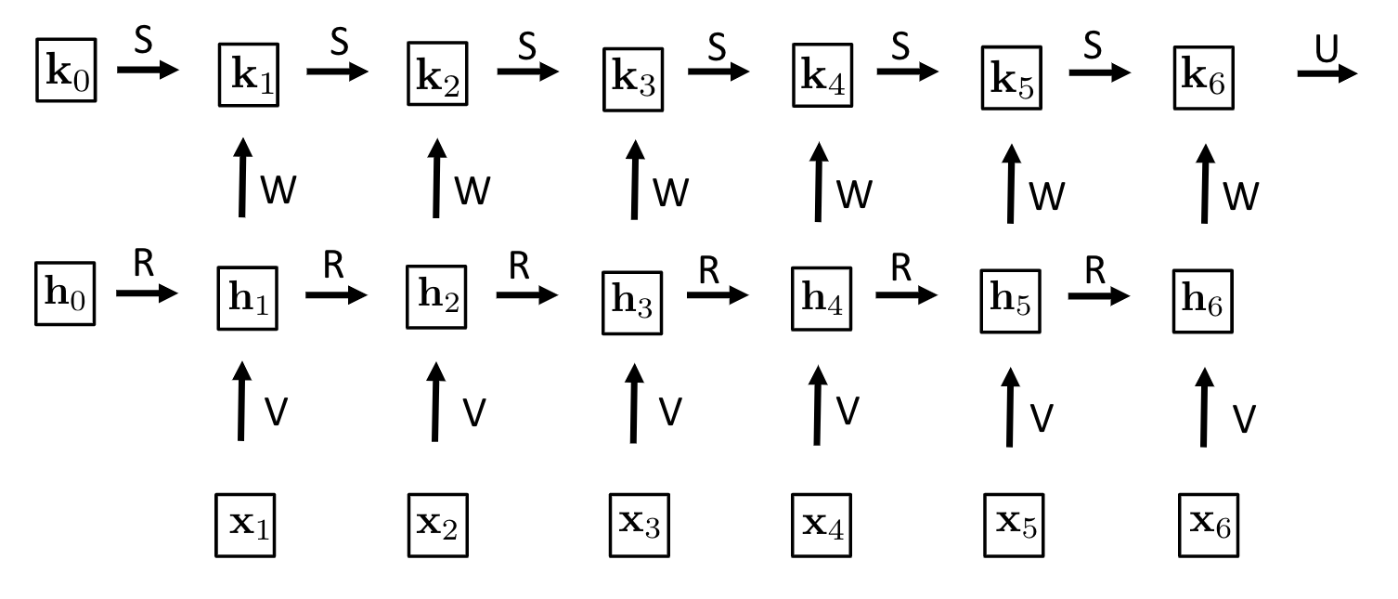
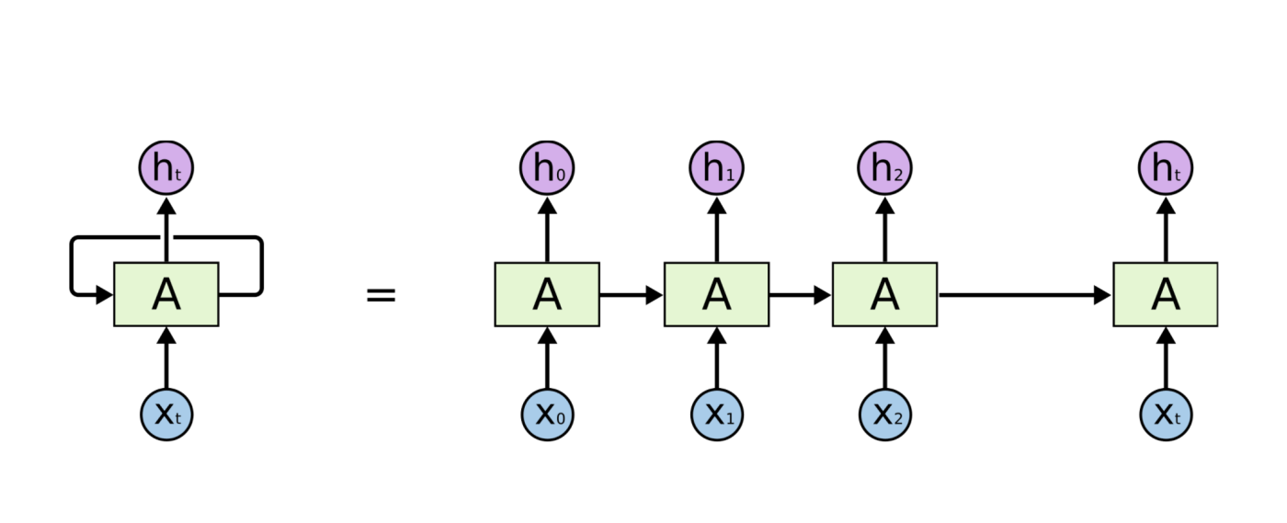
LSTM Networks

Slide 15
Pipeline:

Slide 16
Prediction Results:

Slide 17
Challenges
Data quality
Number of features
Area covered by data (will not work in the entire world)
Environmental engineering knowledge limitation

Slide 18
Status update:
What we have done:
Finished the algorithm got 40% accuracy
Finished Front end
Algorithm is running on Google Cloud
What we will do:
Try to achieve better accuracy

Slide 19
Thank you! Questions?

